Slide 1
Hively Avenue Overpass Project Public Information Meeting #1 In-Person Open House October 22, 2020 5-7pm Zion Missionary Church
Virtual Zoom Meeting
October 20, 2020
5-7pm
www.Zoom.com
Meeting ID: 923 9796 3027
Password: 664032

Slide 2
Virtual Open House Format
This brief presentation will be given by representatives from Michael Baker International
All other participants should mute themselves
Presenters will use their video, and residents may choose whether to use their video
Use the chat feature to ask questions
The chat feature will be monitored throughout the presentation
Once the presentation is complete, questions will be addressed in the order they are received

Slide 3
Agenda Overview
Introductions
Range of Alternatives
Preliminary Preferred Alternative
Questions and Comments
Purpose and Need
Alternative Comparison- Engineering
Project Funding/Overview
Next Steps
Timeline
Project Stakeholders
Community Context/Study Area
Project Contact Information
Alternative Comparison-Environmental/Community
Notes:
Agenda the meeting will follow, most sections are represented with a presentation

Slide 4
Introductions
The Team
INDOT
City of Elkhart
Michael Baker
Burgess and Niple
VS Engineering
SJCA
Compass Outreach Solutions

Slide 5
Project Funding
Local TRAX Rail Overpass Program
Grant to City
INDOT managing the project with local involvement and input
City of Elkhart awarded $12M (2018)
For More Information:
INDOT: https://secure.in.gov/indot/files/Local%20Trax%20Flier%20April2020.pdf
www.elkhartindiana.org: https://www.elkhartindiana.org/egov/apps/document/center.egov?view=item&id=5594
Notes:
*do we have a better INDOT website link?

Slide 6
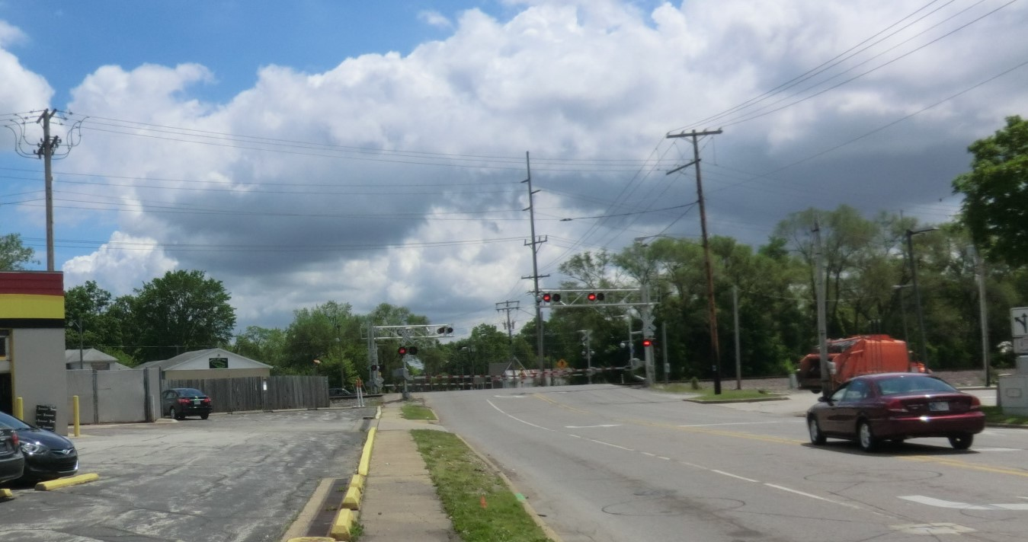
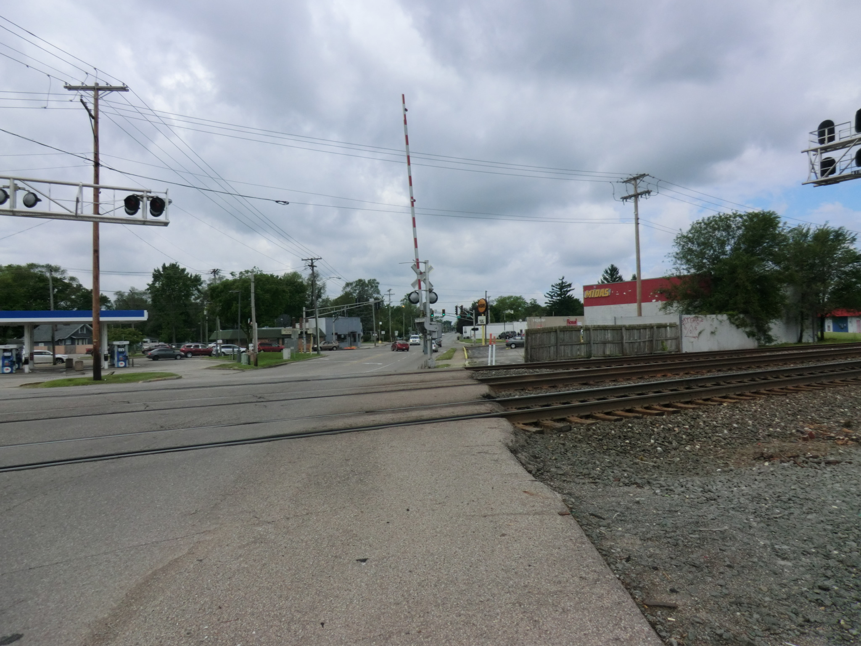
Project Overview
Preliminary Feasibility Study (2017)
Funded by the City of Elkhart
Project Advances with Local Trax Funding (2019)
Phase 1 Engineering and Environmental Studies (On-going)
Engineer’s Report (2019)
Environmental Documentation and Public Outreach (On-going)

Slide 7
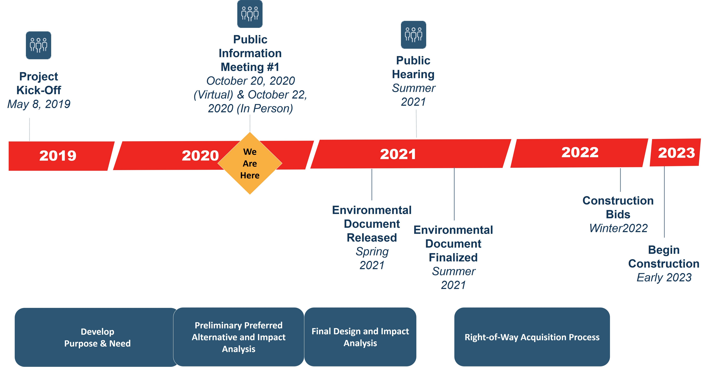
Timeline

Slide 8
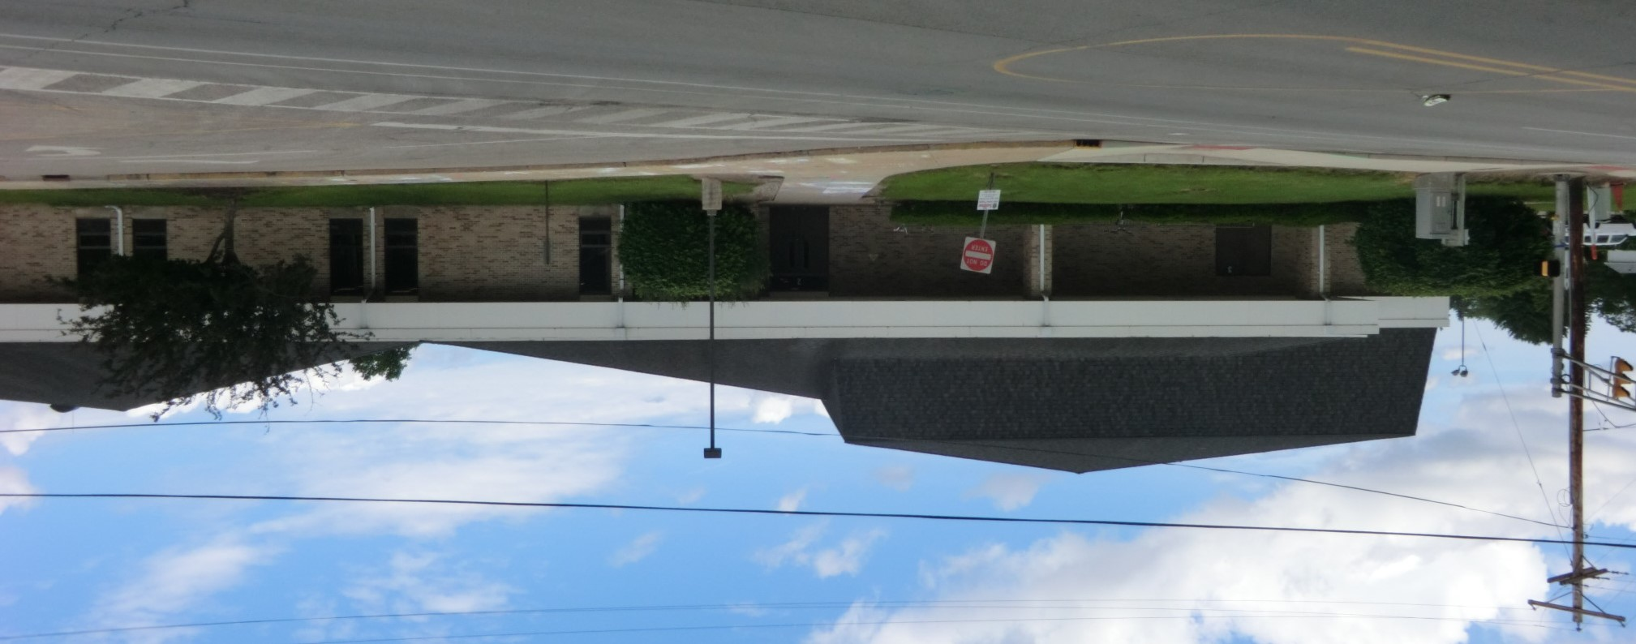
Project Stakeholders
City of Elkhart
INDOT
Elkhart Community Schools
Monger Elementary School
Concord Community Schools
Elkhart County Highway Department
Greater Elkhart Chamber of Commerce
Zion Missionary Church
Concord Fire Department
Elkhart County Sheriff’s Office
Residents
Norfolk Southern RR
Local businesses

Slide 9
Purpose and Need
The project is needed to address traffic congestion, lack of mobility, and safety concerns at the existing at-grade crossing of East Hively Avenue and Norfolk Southern Railroad.
6,000 vehicles traveling along Hively Avenue per day
70-100 trains per day
The purpose of the project is to improve mobility and safety within the project area by eliminating vehicle backups and congestion while maintaining, as much as possible, access and connectivity.
Notes:
Meeting Board

Slide 10
Area Network
E Indiana Ave
Underpass
E Lusher Ave
At-Grade Crossing (Proposed Closure)
Proposed Overpass
Sunnyside Ave
At-Grade Crossing
(Local TRAX future County Overpass)
CR 13
At-Grade Crossing
(Proposed Closure)
Project Location
Adjacent Crossing

Slide 11
Community Context
Use of the existing corridor
Safety
Improve mobility for vehicles, bicyclists, and pedestrians
Local businesses and residential
MapleHeart Trail
Notes:
Insert table

Slide 12
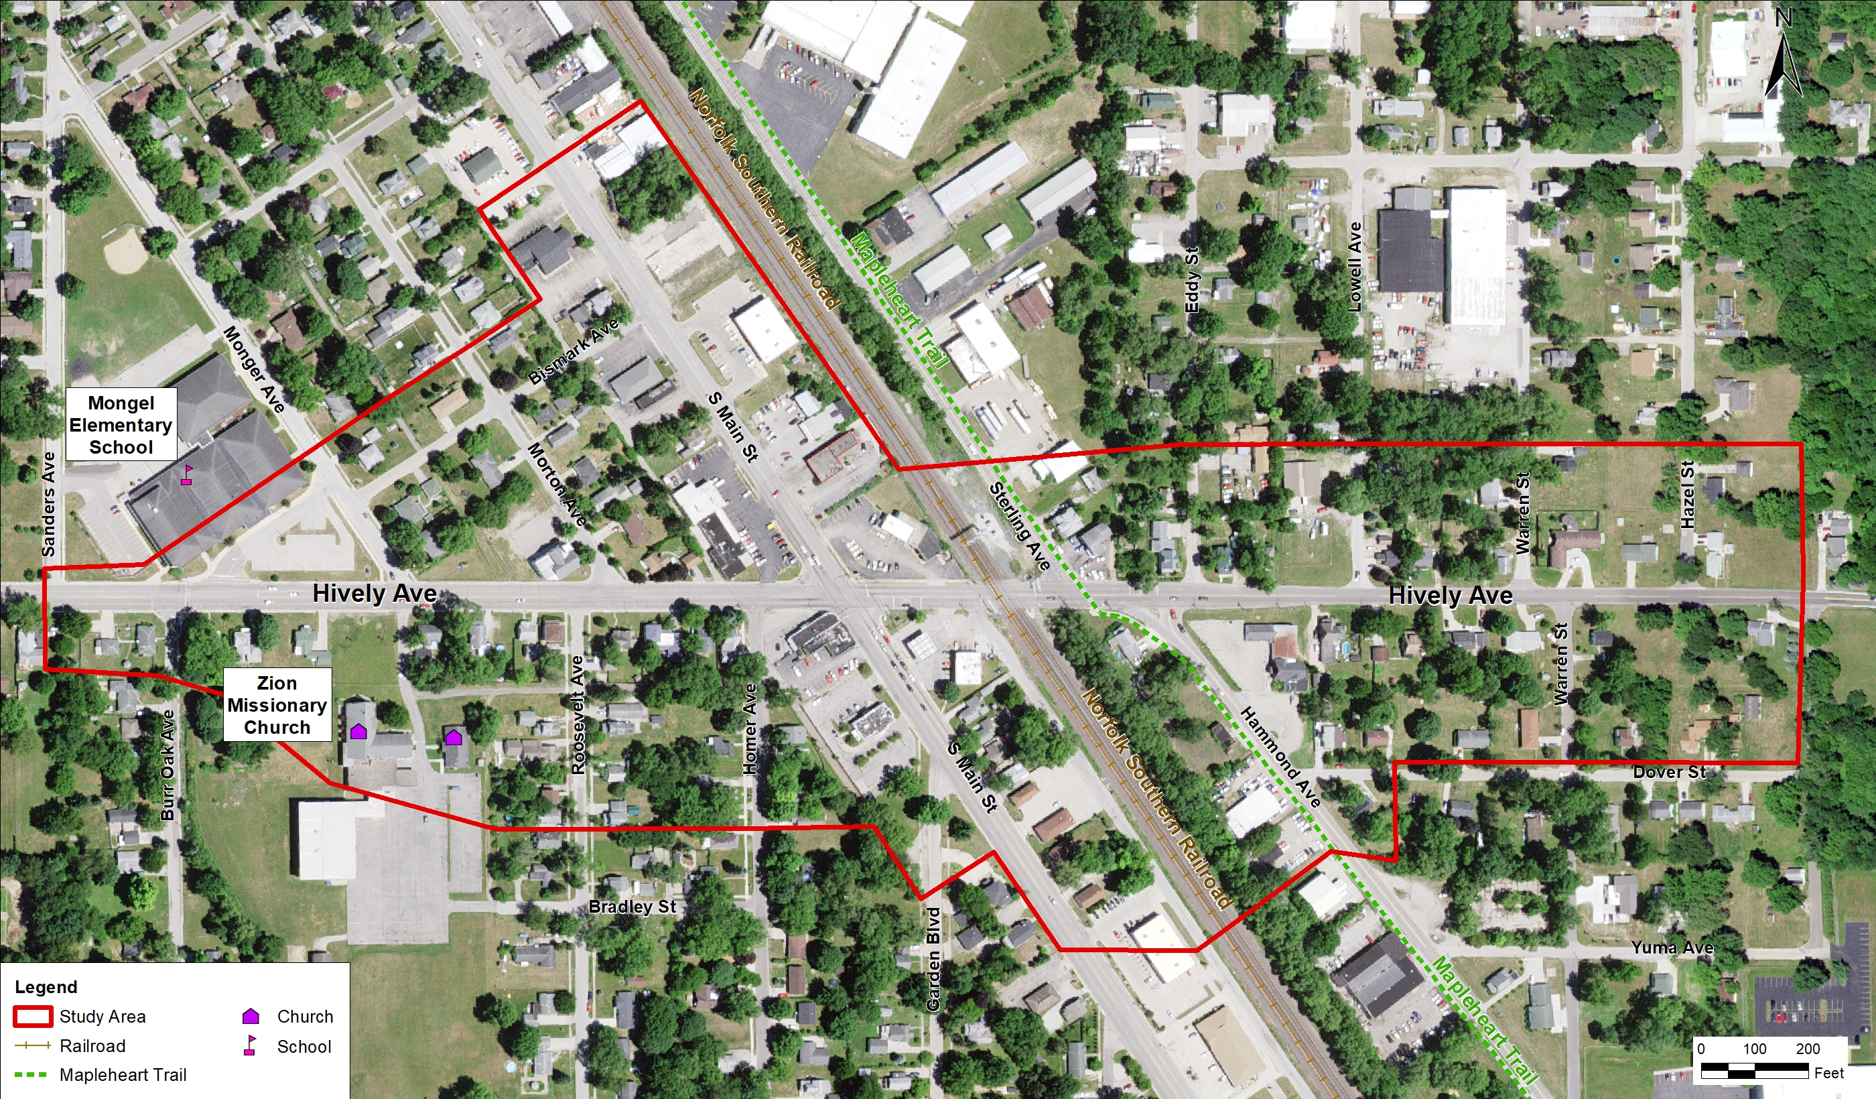
Study Area
r

Slide 13
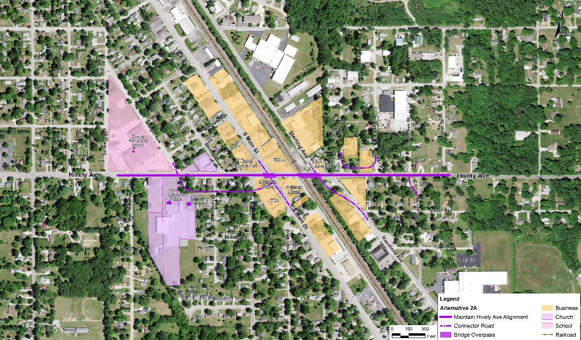
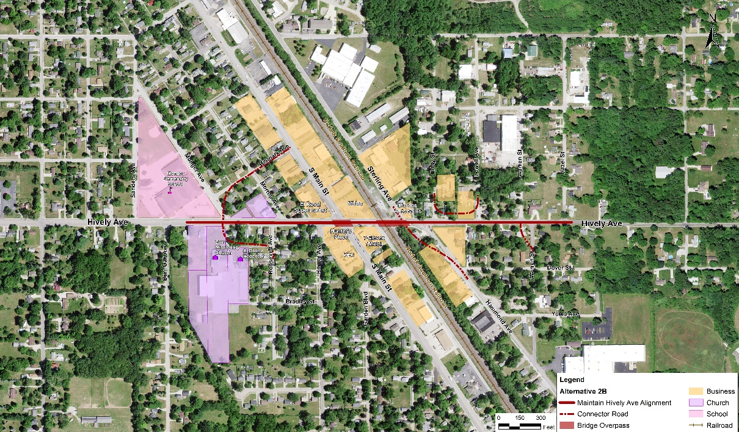
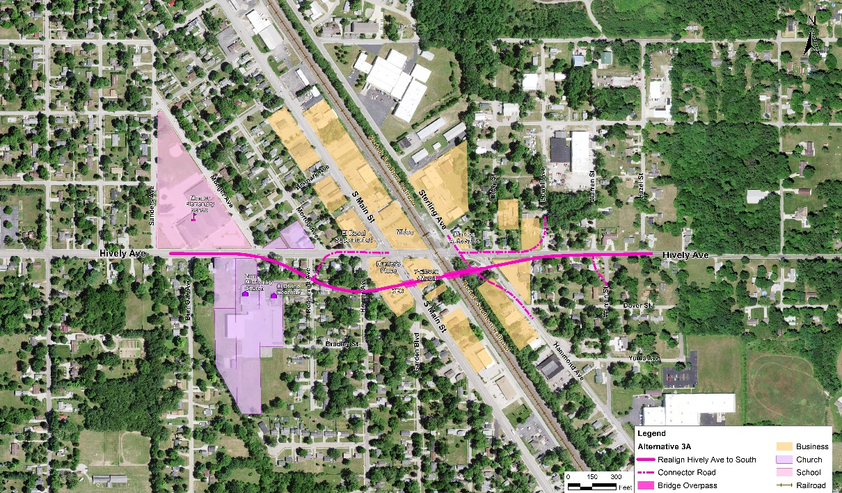
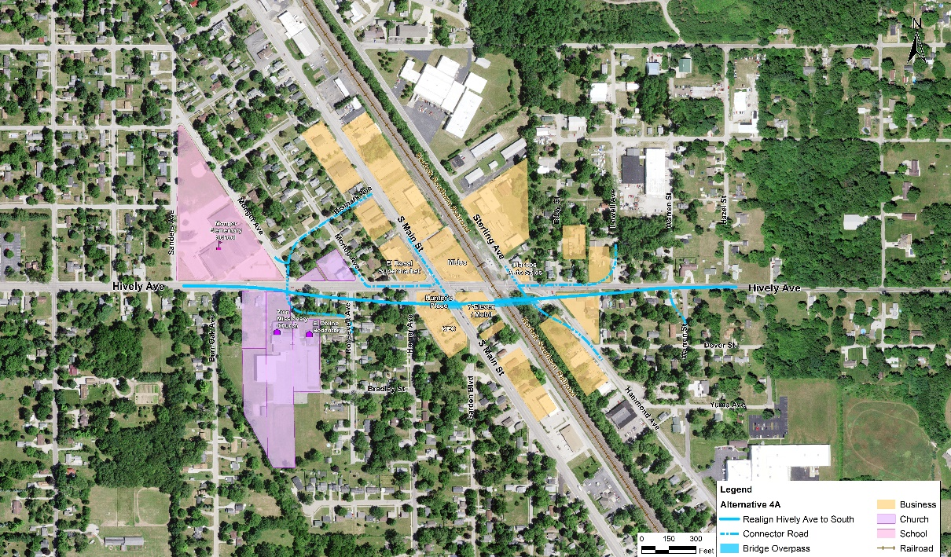
Range of Alternatives
Maintain Hively Ave Alignment with connection roadway to south (2A)
Maintain Hively Ave Alignment with Bismark Ave as connection roadway (2B)
Realign Hively Ave to South with connection roadway to north (3A)
Realign Hively Ave to South with Bismark Ave as connection roadway (4A)
Notes:
Exhibit is a Meeting Board

Slide 14
Range of Alternatives- Alternative 2A
Maintain Hively Ave Alignment with connection roadway to south (2A)

Slide 15
Range of Alternatives-Alternative 2B
Maintain Hively Ave Alignment with Bismark Ave as connection roadway (2B)

Slide 16
Range of Alternatives-Alternative 3A
Realign Hively Ave to South with connection roadway to north (3A)
Notes:
Exhibit is a Meeting Board

Slide 17
Range of Alternatives-Alternative 4A
Realign Hively Ave to South with Bismark Ave as connection roadway (4A)
Notes:
Exhibit is a Meeting Board

Slide 18
Alternative Comparison-Engineering
Key Engineering Considerations | Alternative 2A | Alternative 2B | Alternative 3A | Alternative 4A
Maintains Hively Ave Current Alignment | Yes | Yes | No | No
Short-term Closure of Hively During Construction | No* | No* | Yes | Yes
Desirable Intersection Geometry and Sight Distance | No | No | Yes | No
Maintains Side Street Access | No | No | Yes | Yes
Minimal Traffic Increase on Bismark Ave | Yes | No | Yes | No
Lowest Estimated Construction Cost | No | No | Yes | No
*Long-term closure would be required
Notes:
Insert table

Slide 19
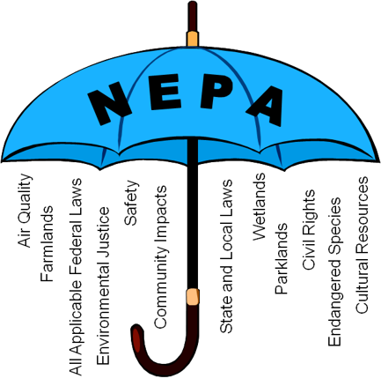
NEPA Umbrella
National Environmental Policy Act (NEPA)
Elkhart Project focus
Safety/mobility
Community Impacts
Property Impacts
Hazardous Materials
Public Resources-trails/parks
Environmental Justice
Notes:
Insert table

Slide 20
Alternative Comparison –Environmental/Community
Benefits/Potential Impacts (Temporary and Permanent) | Alternative 2A | Alternative 2B | Alternative 3A | Alternative 4A
Improved Safety and Mobility | Yes | Yes | Yes | Yes
Bike/Pedestrian Improvements | Yes | Yes | Yes | Yes
Community Impacts | Minimum | Minimum | Minimum | Minimum
Property Impacts
Residential | 37 | 30 | 35 | 34
Commercial | 11 | 7 | 10 | 8
Other/Community | 4 | 5 | 2 | 4
Potential Hazardous Waste Sites (combination of high and medium potential sites) | 4 | 4 | 4 | 5
Public Resources (MapleHeart Trail) | Temporary | Temporary | Temporary | Temporary
Environmental Justice Considerations | Potential | Potential | Potential | Potential
Notes:
Insert table

Slide 21
Preliminary Preferred Alternative 3A
Notes:
Table is a Meeting Board

Slide 22
Preliminary Preferred Alternative 3A-Benefits
Mobility Improvement
Vehicles
Bicyclists/pedestrians
Hively Remains Open For A Majority of Construction Period
Intersections Will be Safer While Maintaining Side Street Access
Minimize Business Impacts
Lowest Cost Alternate
Notes:
Table is a Meeting Board

Slide 23
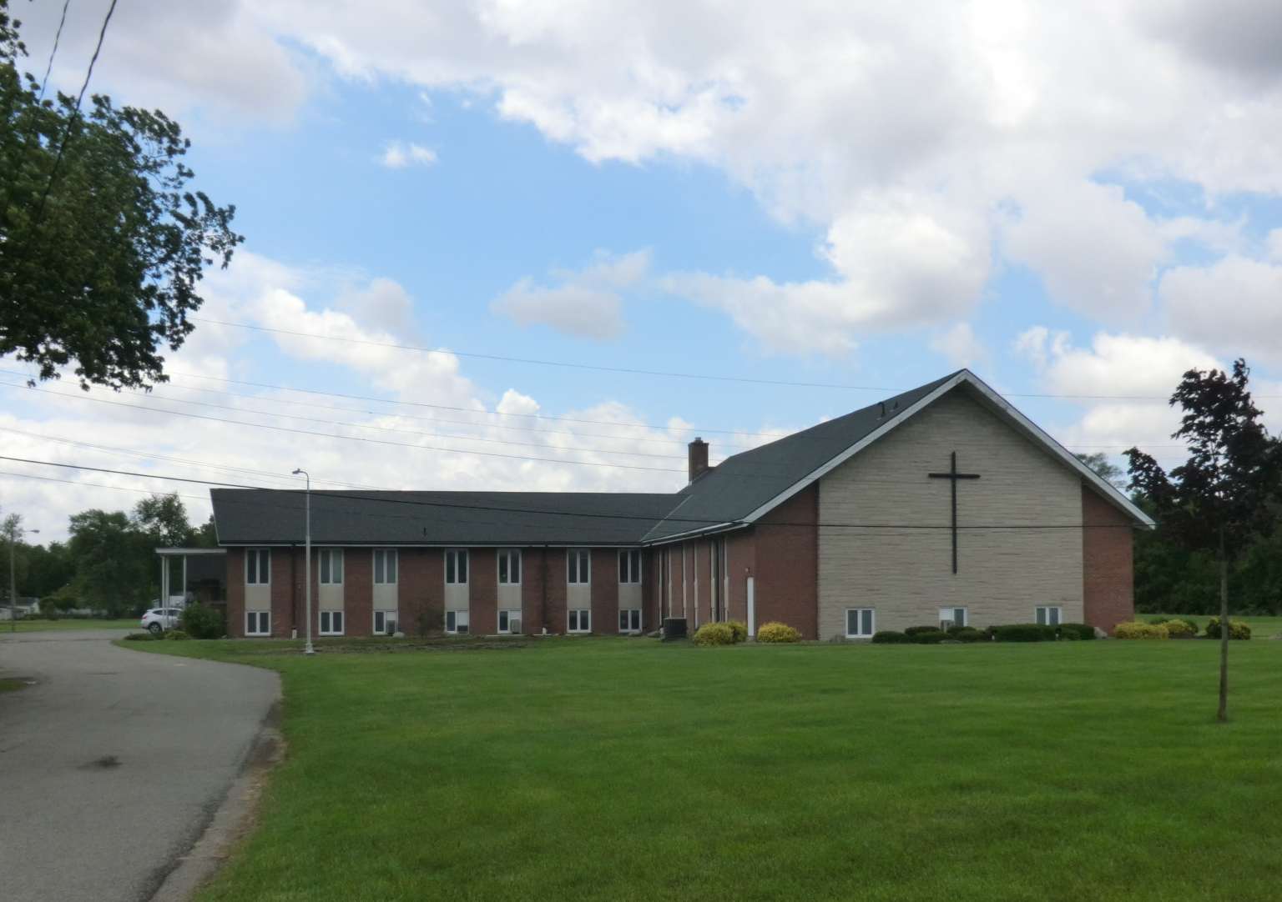
Join us Thursday, October 22
In-person Public Information Meeting Thursday:
October 22, 2020
Time: 5pm-7pm
Where: Zion Missionary Church
1135 E. Hively Avenue
Zion Missionary Church
1135 E. Hively Avenue, Elkhart, IN 46517
Notes:
Insert table

Slide 24
Next Steps
Ongoing: Refine engineering design
Fall 2020 : Soil borings and field investigations
Summer 2021: Publish environmental document
Summer 2021: Public Hearing
Fall 2021: Right of way acquisition

Slide 25
Questions and Comments
*Use the chat feature to ask questions
Notes:
Open floor for questions and comments, explain comment forms and contact information.

Slide 26
Ways to Comment
All written inquiries and comments can be sent by email via email at
ElkhartLocalTrax@mbakerintl.com
Or by mail at
3815 River Crossing Parkway, Suite 20
Indianapolis, IN 46240

Slide 27
Additional Information
www.elkhartindiana.org
www.indot.in.gov
@CityOfElkhartIN
@INDOTNortheast
@CityofElkhartIN
@INDOTNortheast

Slide 28
Project Contact Representatives Information
Consultant Representative, Michael Baker International
Contact: Charles Boltz
Phone: 317-663-8430
Local Representative, City of Elkhart
Contact: Ryan Clussman
Office Phone: 574-293-2572 ext 2222
State Representative, INDOT
Contact: Jason Holder
Office Phone: 317-233-3427

Slide 29
THANK YOU!

