Slide 1


In-Person
August 31, 2021
5pm-7pm
Zion Missionary Church
Hively Avenue Overpass Project Public Information Meeting #3
Notes:
Board (2)

Slide 2
Agenda
Project Team Information
Overview and Timeline
Preliminary Preferred Alternative including Truck Route
Environmental Analysis and Preliminary Property Impacts
Comments and Feedback
Next Steps and Timeline

Slide 3







Welcome & Introductions
Project Team Members:
  INDOT
  City of Elkhart
  Michael Baker
  Burgess and Niple
  VS Engineering
  SJCA
  Compass Outreach Solutions

Slide 4
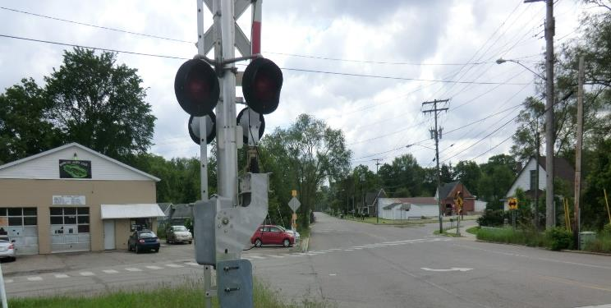
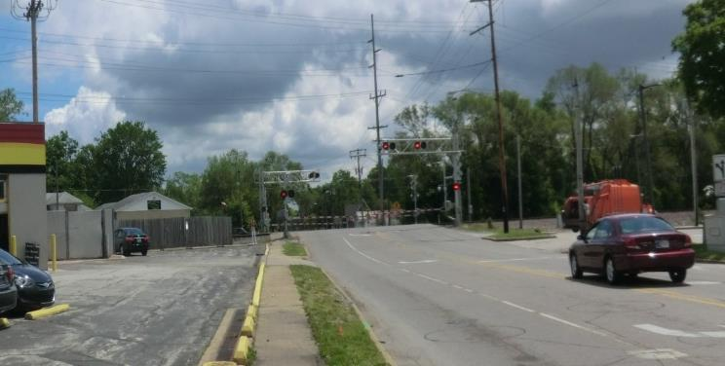
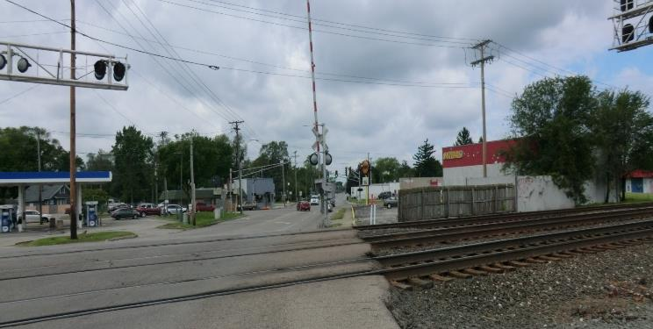
Brief Project Overview
Elkhart funded Preliminary Feasibility Study (2017)
Project Advances with Local Trax Funding (2019)
Phase 1 Engineering and Environmental Studies (On-going)
  Engineer’s Report (2019)
  Public Meeting (virtual and in-person) in October 2020
  Approved Environmental Document expected in early 2022- *This is the critical path for property acquisitions for right-of-way.

Slide 5
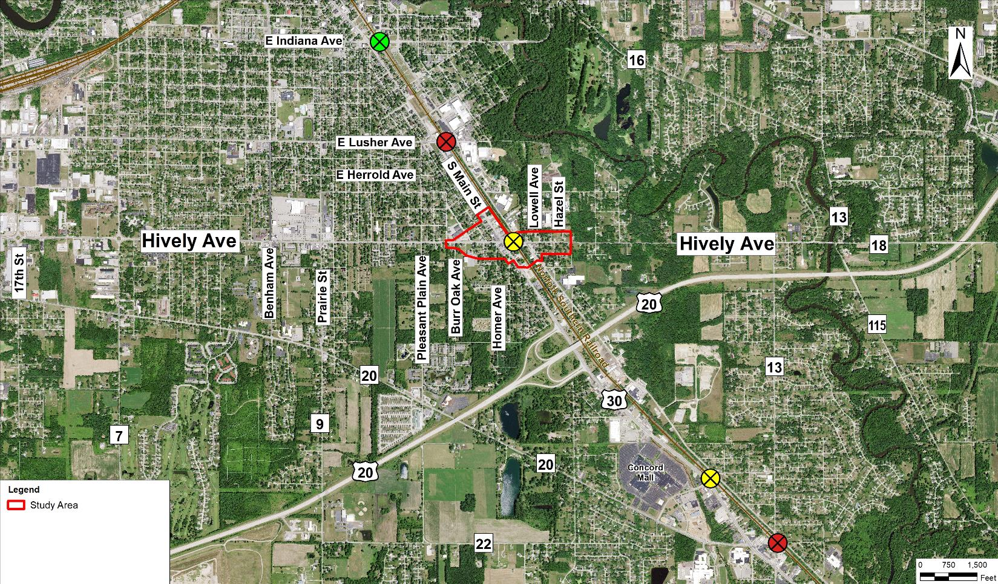
Area Network
E Indiana Ave
Underpass
E Lusher Ave
At-Grade Crossing (Proposed Closure)
Proposed Overpass
Sunnyside Ave
At-Grade Crossing
(Local TRAX future County Overpass)
CR 13
At-Grade Crossing
(Proposed Closure)
Existing At-Grade Crossing
Proposed Crossing Overpass
Proposed Crossing Closure

Slide 6
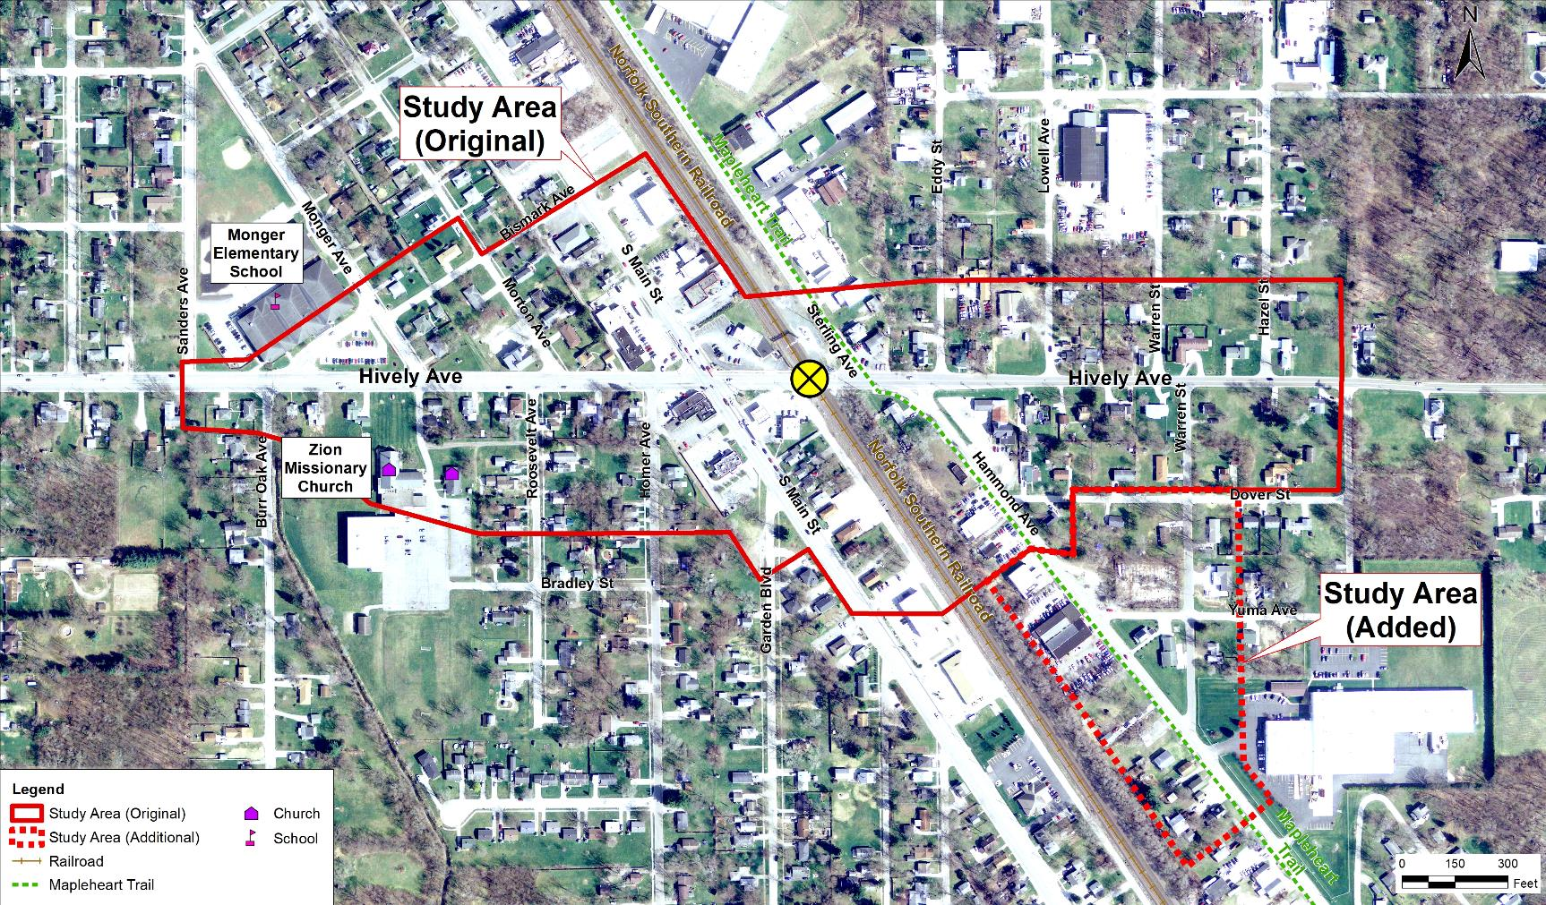
Study Area
r
Existing
At-Grade
Crossing
At-Grade
Crossing

Slide 7
Purpose and Need
The project is needed to address traffic congestion, lack of mobility, and safety concerns at the existing at-grade crossing of East Hively Avenue and Norfolk Southern Railroad.
  6,000 vehicles traveling along Hively Avenue per day
  70-100 trains per day
The purpose of the project is to improve mobility and safety within the project area by eliminating vehicle backups and congestion while maintaining, as much as possible, access and connectivity.
Notes:
Meeting Board

Slide 8
Existing Conditions/Deficiencies & Proposed Improvements
Stopped Traffic Movements
  Traffic will continue to flow for bicyclists, pedestrians, and vehicles and there will be limited disruptions during construction
Drainage and Utilities
  Working with the City to determine utility impacts and improvements
Sidewalks/Trail Connection
  New ADA compliant sidewalks will provide connection to the Maple Heart Trail and other side streets
Truck Movements
  Identified official truck route on Warren St., south to Hammond.

Slide 9


Timeline/Next Steps
Public Information Meeting #3
August 31, 2021
Public Information
Meeting #1 & #2
October 20 (Virtual) & October 22, 2020 (In Person)
Project
Kick-Off
May 8, 2019
Public Hearing
Winter 2022
Roadway Open
Anticipated
Summer 2025
We Are Here
2019
2020
2021
2022
2023
2024
2025
Environmental Document Released
Winter
2021
Construction
Bids
Spring 2023
Environmental Document Finalized
Early
2022
Construction Begins
Summer 2023
Develop
Purpose & Need
Preliminary Preferred Alternative & Impact Analysis
Finalize Design and Impact Analysis
ROW Process
Construction
Notes:
This is a board. And, maybe a handout?

Slide 10
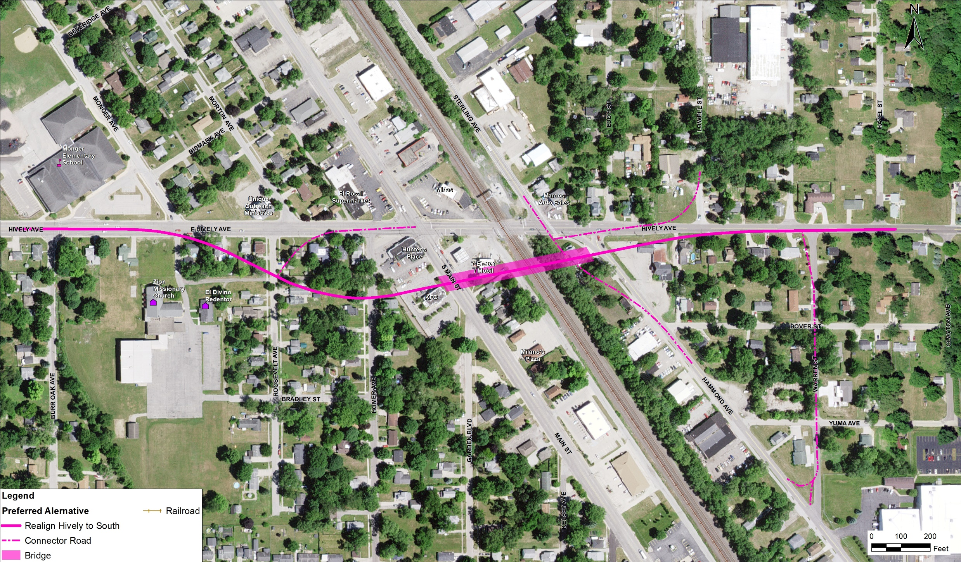
Preliminary Preferred Alternative
Notes:
Exhibit from the October 2021 public meeting(s). the Truck Route Study Area was added later as a result of public comments regarding truck movements.

Slide 11
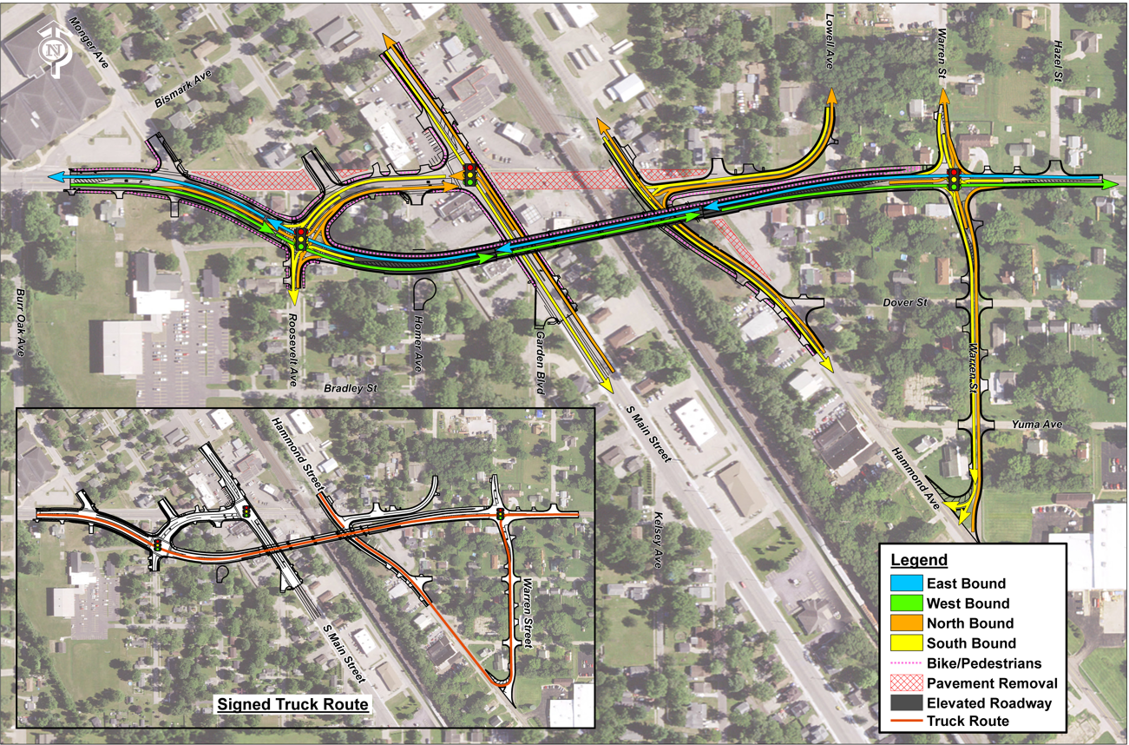
Preliminary Preferred Traffic Flow

Slide 12
Environmental Analysis Update
The environmental document is in process.
  Draft environmental document will be published prior to the Public Hearing.
Based on Public Outreach, the team re-evaluated truck movements and recommends a Truck Route utilizing existing Warren Street.
  This has been incorporated into the design and preliminary environmental documentation.
Sensitive resources, hazardous materials, property impacts, and construction duration are key concerns.
  Avoidance and minimization of impacts to property, travel during construction and post construction access and mobility continue to be incorporated into plan designs.

Slide 13
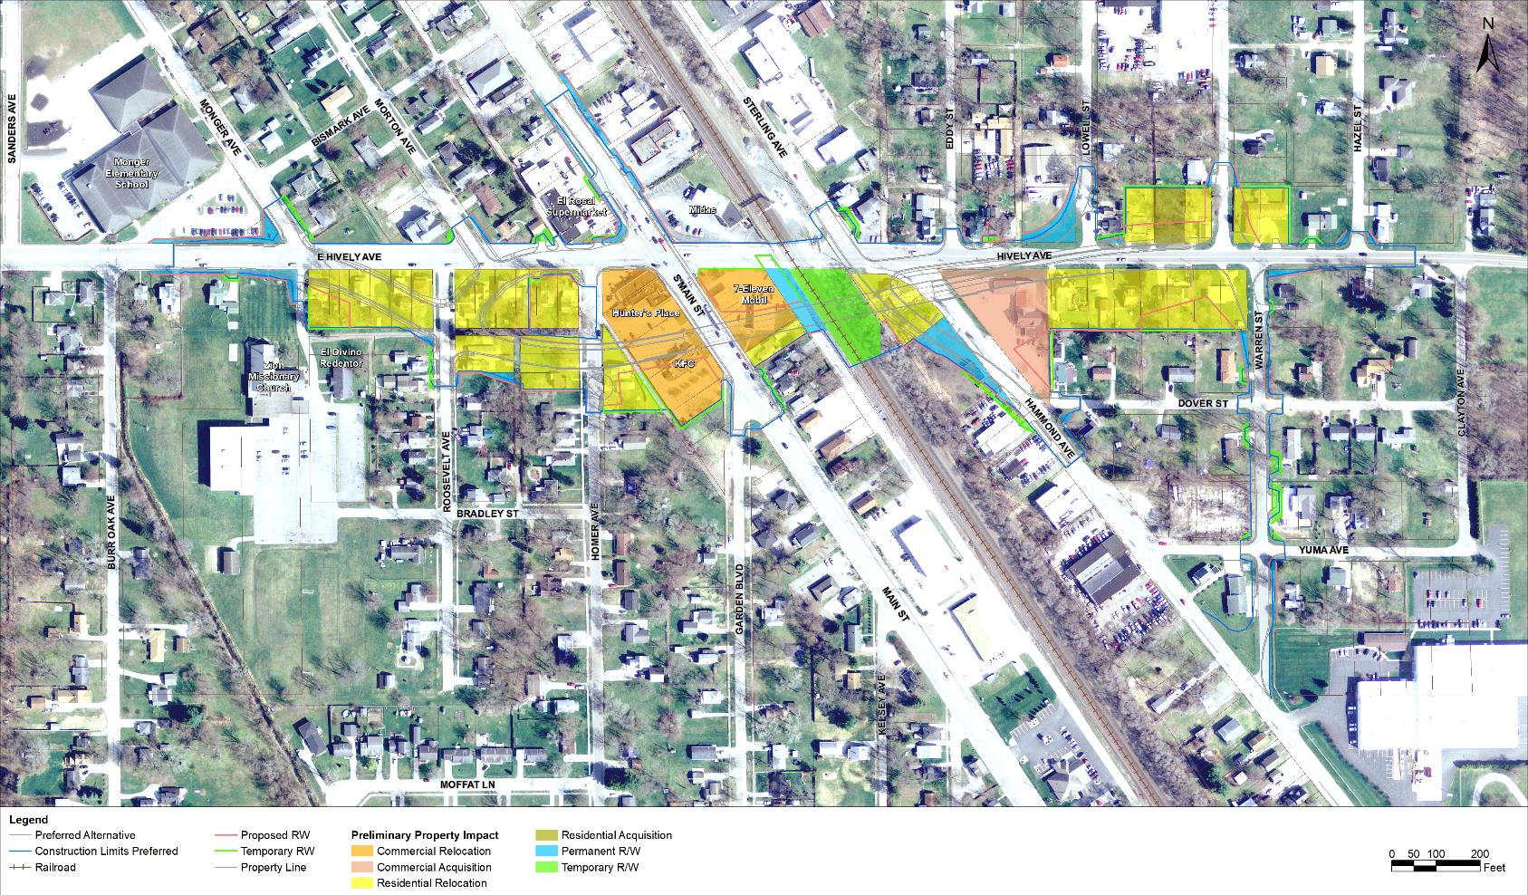
Preliminary Preferred ROW and Property Impacts
Notes:
Board (4)

Slide 14
Preliminary Preferred Alternative: Anticipated Property Impacts
Land Use | # of Relocations | # of Acquisitions | Total Permanent ROW (acres) | Total Temporary ROW (acres)
Residential | 20 | 1 | 6.50 | 0.12
Commercial | 4 | 1 | 3.81 | 0.10
Other (Church, School, Utility) | 0 | 0 | 0.37 | 0.57
Total: | 24 | 2 | 10.68 | 0.79
Notes:
Board (4)

Slide 15
Preliminary Preferred Alternative: Sensitive Resources and Analysis
Continue to minimize property impacts:
  Homes, Businesses, Monger School, Zion Missionary Church and Grocery Store
No anticipated impacts to historic or cultural resources
No significant noise or air quality impacts based on current noise and future traffic volumes
Potential property impacts include hazardous materials considerations; additional analysis is in progress
Environmental justice and community impacts

Slide 16
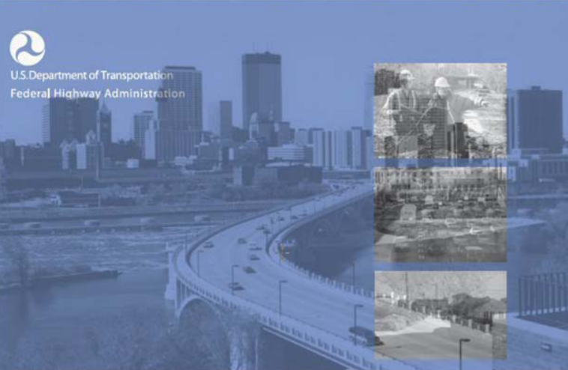
Additional Information on Property Acquisition & Relocations
RELOCATION
YOUR RIGHTS AND BENEFITS AS A DISPLACED PERSON UNDER THE FEDERAL
RELOCATION ASSISTANCE PROGRAM
SUS DERECHOS Y BENEFICIOS COMO PERSONA DESPLAZADA DE ACUERDO CON EL PROGRAMA FEDERAL DE ASISTENCIA PARA LA REUBICACIÓN
ACQUISITION
ACQUIRING REAL PROPERTY FOR FEDERAL AND FEDERAL-AID PROGRAMS AND PROJECTS
More information can be found at:
https://www.in.gov/indot/projects/files/FHWA-Relocation-Brochure-GREEN.pdf
https://www.in.gov/indot/projects/files/FHWA-Relocation-Brochure-SPANISH.pdf
https://www.in.gov/indot/projects/files/FHWA-Acquisition-Brochure-BLUE.pdf
Notes:
Handout

Slide 17
Timeline/Next Steps
Public Information Meeting #3
August 31, 2021
Public Information
Meeting #1 & #2
October 20 (Virtual) & October 22, 2020 (In Person)
Project
Kick-Off
May 8, 2019
Public Hearing
Winter 2022
Roadway Open
Anticipated
Summer 2025
We Are Here
2019
2020
2021
2022
2023
2024
2025
Environmental Document Released
Winter
2021
Construction
Bids
Spring 2023
Environmental Document Finalized
Early
2022
Construction Begins
Summer 2023
Develop
Purpose & Need
Preliminary Preferred Alternative & Impact Analysis
Finalize Design and Impact Analysis
ROW Process
Construction
Notes:
This is a board. And, maybe a handout?

Slide 18



Additional Information
www.elkhartindiana.org
www.indot.in.gov
@CityOfElkhartIN
@INDOTNortheast
@CityofElkhartIN
@INDOTNortheast

Slide 19
How to Provide Comments
Please direct all inquiries and comments via email:
ElkhartLocalTrax@mbakerintl.com
OR mail:
Michael Baker International 3815 River Crossing Parkway, Suite 20 Indianapolis, IN 46240

Slide 20


Project Contact Representatives Information
Consultant Representative, Michael Baker International
Contact: Charles Boltz
Phone: 317-663-8430
Local Representative, City of Elkhart
Contact: Ryan Clussman
Office Phone: 574-293-2572 ext 2222
State Representative, INDOT
Contact: Jason Holder
Office Phone: 317-233-3427

Slide 21

THANK YOU!

